Slide 1

DATA STORYTELLING TECHNIQUES for Interactive Decision Analytics
​ Domain: Business Analytics
BATCH NO – 10
2420030121-S SAI RISHIK
2420030140- R SAI CHARAN
2420030574-D SUJAY
2420030764-K SAI TEJA

Slide 2

Methodology
Data Collection:
Collected four sales datasets: Superstore, Global Superstore, Online Sales, and Supermarket datasets.
Data Preprocessing:
Cleaned the datasets by removing duplicates, handling missing or invalid values, standardizing column names, and converting numeric and date fields into appropriate formats.
Data Integration:
Integrated multiple datasets into a single dashboard framework and normalized common analytical fields such as Sales, Profit, Quantity, Category, Region, and Segment.
Exploratory Data Analysis:
Analyzed sales trends, category performance, regional performance, customer segments, top products, profitability, and discount-profit relationships.
Feature Engineering:
Created useful features such as Year, Month, Month Name, Quarter, and Profit Margin wherever the source data supported them.
Machine Learning:
Implemented a Random Forest Regressor to predict Sales using relevant features such as Quantity, Discount, Category, Sub-Category, Region, Segment, Year, Month, and Payment Mode where available.
Model Evaluation:
Evaluated the regression model using R² Score, Mean Absolute Error (MAE), and Root Mean Squared Error (RMSE).
Visualization & Dashboard:
Presented KPIs, interactive charts, ML prediction results, Data Story, and Decision Analytics through an interactive web dashboard.

Slide 3
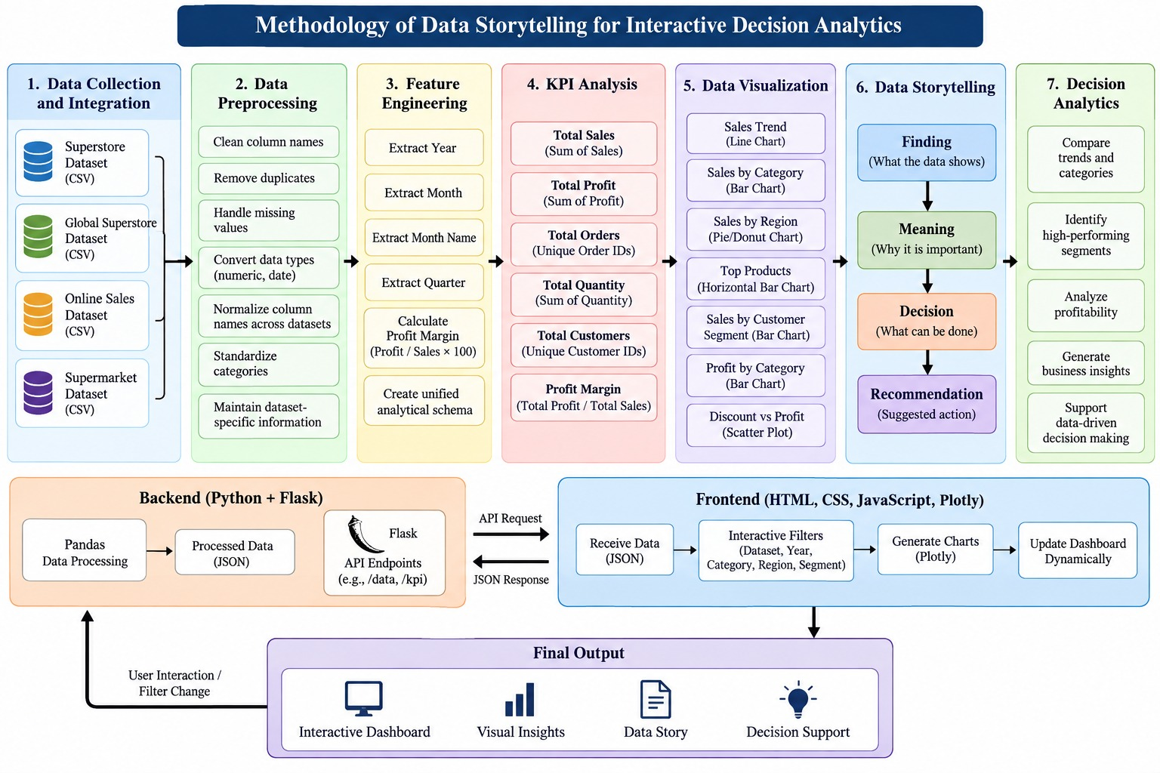
System Design

Slide 4
Modern Tools & Technologies
Category | Tool / Technology | Purpose in the Project
Programming Language | Python | Core language for data analysis, preprocessing, ML, and project implementation
Development Environment | Jupyter Notebook | Data analysis, experimentation and development
Data Processing | Pandas | Data loading, cleaning, transformation, and analysis
Data Visualization | Plotly | Interactive business charts and dashboard visualization
Frontend | HTML, CSS, JavaScript | Dashboard structure, design and interaction
Backend | Flask | Random Forest regression and model evaluation
Data Storage | CSV | Storing the four sales datasets

Slide 5
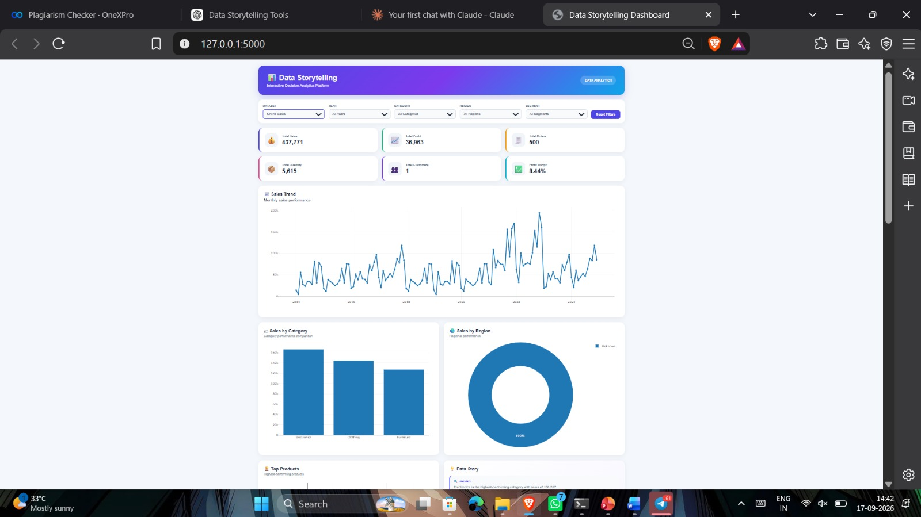
Implementation

Slide 6
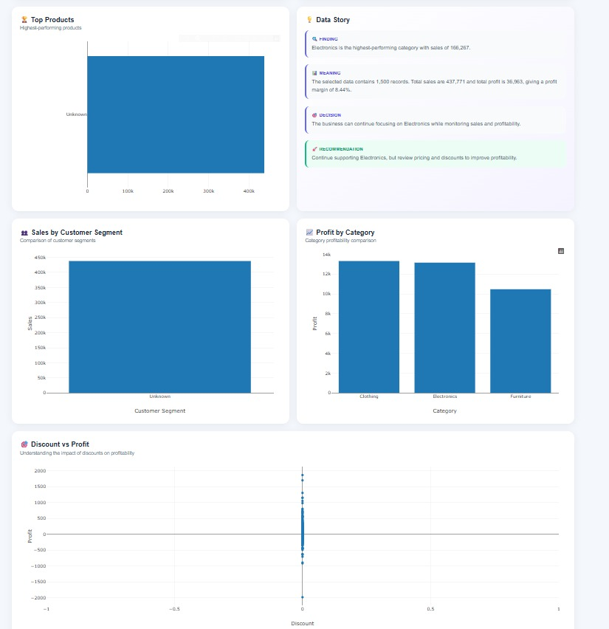

Slide 7
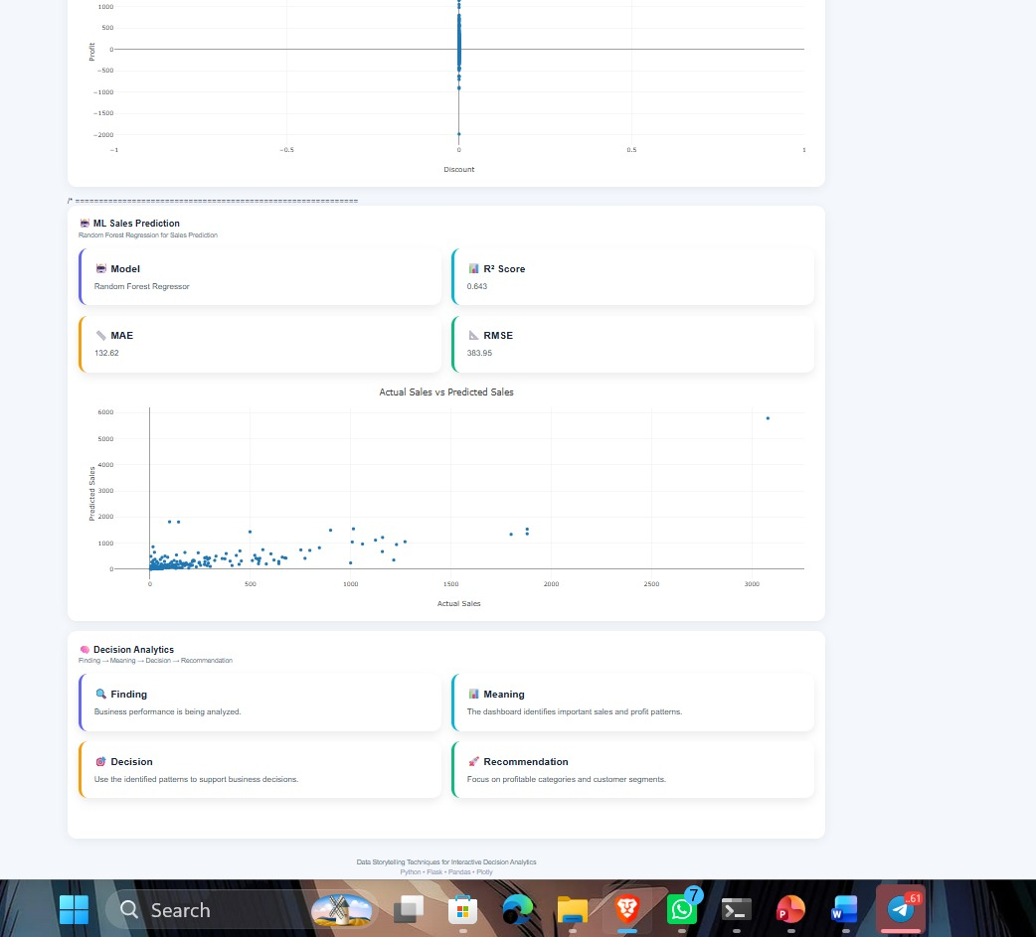

Slide 8
Results
Data Processing:
Successfully cleaned and normalized four different sales datasets for dashboard analysis.
EDA Findings:
Identified sales trends, category performance, regional performance, customer segment behavior, product rankings, profitability, and discount-profit patterns.
Feature Engineering:
Created Year, Month, Quarter, and Profit Margin features where applicable.
Dashboard Outcome:
Implemented interactive dataset selection, dynamic filters, KPI analysis, and multiple Plotly visualizations.
Machine Learning Outcome:
Implemented Random Forest Regression for Sales Prediction and integrated model evaluation into the dashboard.
Data Story Outcome:
Converted analytical findings into:
Finding → Meaning → Decision → Recommendation
Final Outcome:
Cleaned Data → EDA → Features → ML Prediction → Visualization → Data Story → Decision Analytics

Slide 9
DATA STORYTELLING TECHNIQUES
1. KPI Storytelling
Dashboard: Total Sales, Total Profit, Total Orders, Total Quantity, Total Customers, Profit Margin
Explanation:
KPIs provide a quick summary of overall business performance before detailed analysis.
2. Trend Storytelling
Dashboard: Sales Trend Line Chart
Explanation:
Shows how sales change over time and helps identify increases, decreases, peaks, and low-performing periods.
3. Comparison Storytelling
Dashboard: Sales by Category, Profit by Category
Explanation:
Compares categories to understand differences in sales and profitability.
4. Geographical Storytelling
Dashboard: Sales by Region
Explanation:
Shows how sales are distributed across regions and helps compare regional performance.
5. Ranking Storytelling
Dashboard: Top Products
Explanation:
Ranks products by sales and makes high-performing products easy to identify.

Slide 10
6. Segment Storytelling
Dashboard: Sales by Customer Segment
Explanation:
Compares customer groups and identifies their contribution to sales.
7. Relationship Storytelling
Dashboard: Discount vs Profit Scatter Plot
Explanation:
Examines the relationship between discount levels and profit.
8. Interactive Storytelling
Dashboard: Dataset, Year, Category, Region, Segment Filters
Explanation:
Allows users to interact with the data and explore different views by changing datasets and filters.
9. Narrative Storytelling
Dashboard: Data Story
Flow:
Finding → Meaning → Decision → Recommendation
Explanation:
Converts chart results into a clear business narrative by explaining what the data shows, what it means, what decision can be considered, and what recommendation follows.
10. Decision-Oriented Storytelling
Dashboard: Decision Analytics
Explanation: Connects analytical findings with business decision-making and provides structured decision support.

Slide 11
Comparative Analysis
Four regression models were evaluated using the same dataset, features, and 80:20 train-test split.
R² measures how much variation in sales is explained by the model.
MAE measures the average absolute prediction error.
RMSE gives greater weight to larger prediction errors.
The model with higher R² and lower MAE/RMSE provides stronger predictive performance for that test setup.
Model performance can vary when a different dataset is selected because the underlying data and available features change.

Slide 12
Performance Evaluation
Model Evaluation
Evaluated the Random Forest Regressor for Sales Prediction.
Evaluation Metrics
R² Score: Measures how well the model explains the variation in Sales.
MAE: Measures the average absolute difference between actual and predicted Sales.
RMSE: Measures prediction error while giving greater weight to larger errors.
Model Validation
Used an 80:20 train-test split.
Trained the model on the training set.
Generated predictions on unseen test data.
Compared actual and predicted sales.
Displayed model performance metrics in the dashboard.
Functional Evaluation
Tested:
Dataset switching
Dynamic filters
KPI calculations
Chart rendering
ML prediction section
Data Story updates
Reset Filters
Final Outcome:
ML Model → Performance Metrics → Actual vs Predicted → Data Story → Decision Support

Slide 13
Thank you

